Slide 1
RAG and AI
Data Science Club @ NKU

Slide 2
Introduction
Definition: RAG is a technique for enhancing the accuracy and reliability of generative AI models by fetching facts from external sources.
Purpose: It addresses limitations in traditional large language models (LLMs) by providing them access to current, specific information, improving their relevance and depth of response.

Slide 3
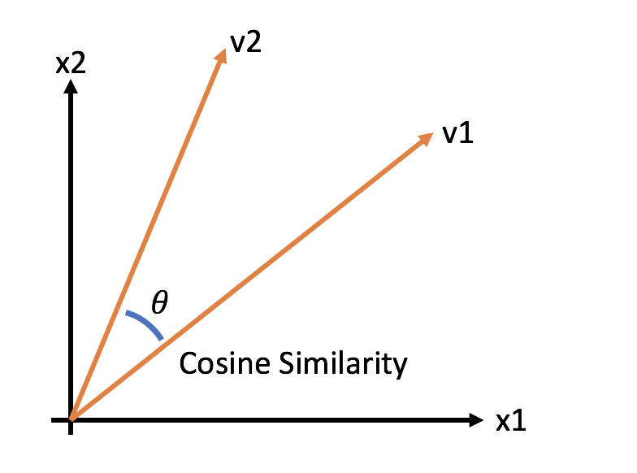
Understanding Vector Embeddings
Definition: Vector embeddings represent objects (e.g., words, images) as dense vectors that capture their semantic information.
Cosine Similarity:
Definition: Measures the cosine of the angle between two vectors. It’s particularly useful for high-dimensional data when the magnitude of vectors is less important than their direction.

Slide 4
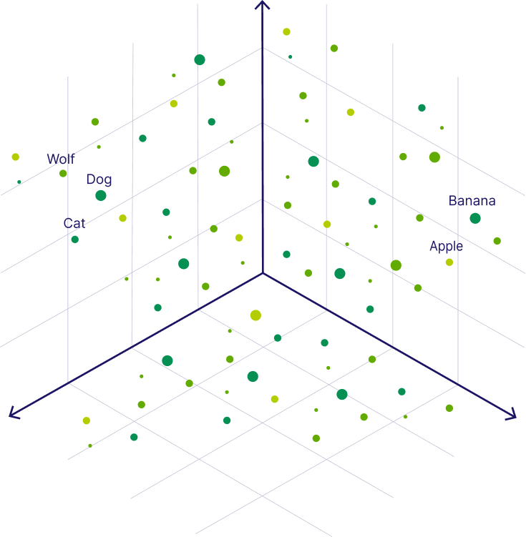
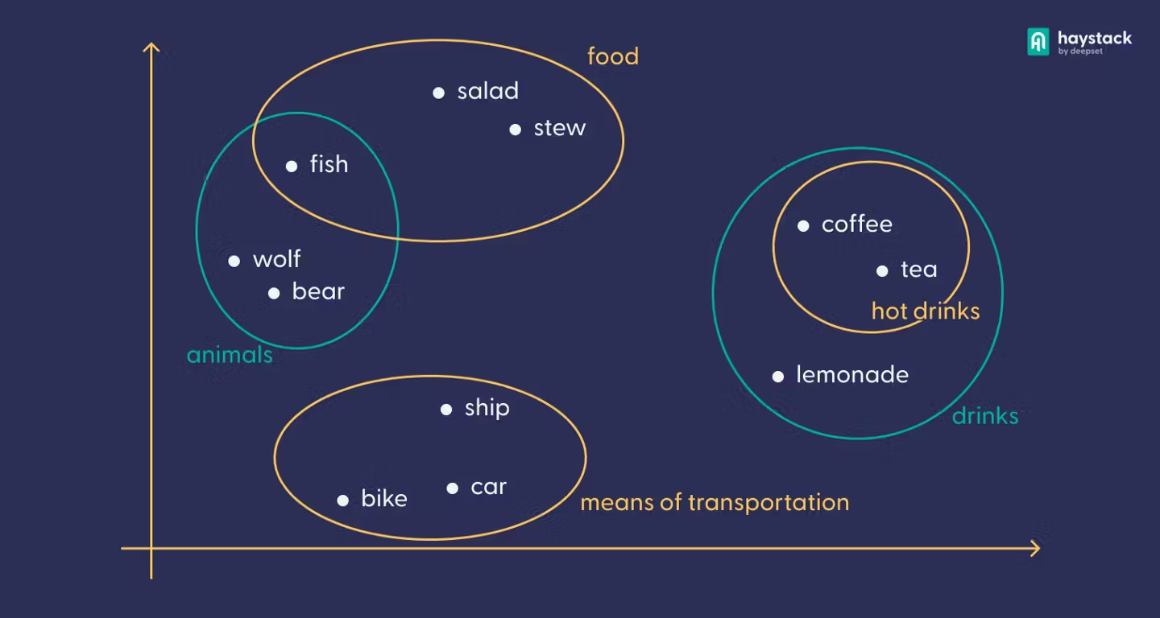

Slide 5
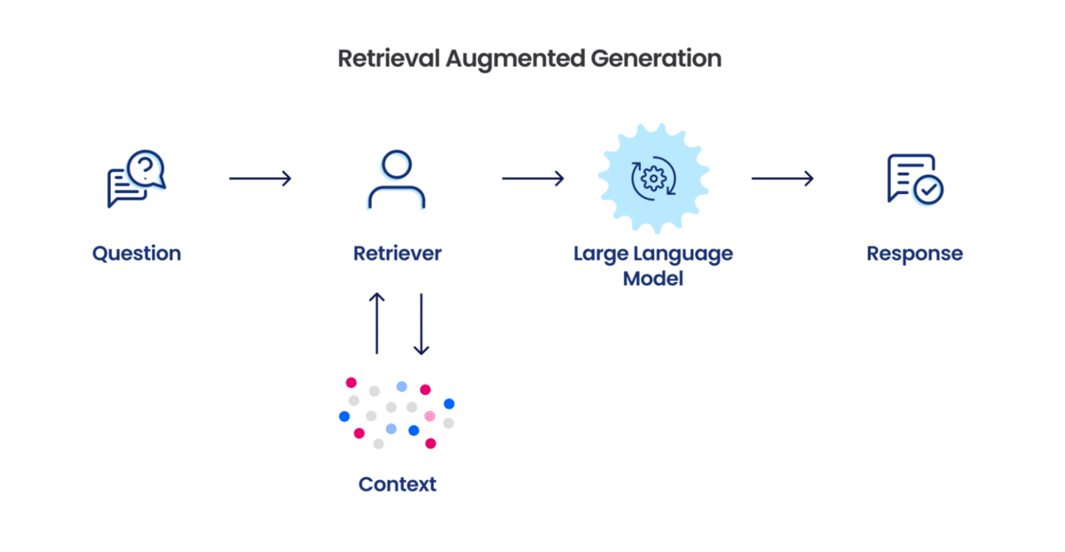
Architecture Overview

Slide 6
Loading Documents
Goal: Prepare the data for efficient processing.
Process:
Load documents from URLs, PDFs, or databases.
Break large documents into smaller, meaningful chunks (splits).
Ensure each chunk is independent and informative.
Output: Structured and manageable chunks of data ready for storage.

Slide 7
Storage in Vector Database
Goal: Organize data for fast and accurate retrieval.
Process:
Convert data chunks into vector embeddings (numerical representations).
Store embeddings in a vector database (e.g., Pinecone, Weaviate).
Create a searchable system optimized for similarity-based searches.
Output: A vectorized database of data chunks prepared for retrieval.

Slide 8
Retrieval
Goal: Find the most relevant data for a user query.
Process:
Convert the query into a vector embedding.
Search the vector database to retrieve the most similar data chunks (relevant splits).
Return these splits as context for the next step.
Output: A set of relevant splits closely matched to the query.

Slide 9
Output Generation
Goal: Generate a well-informed response using retrieved data.
Process:
Combine the query and retrieved splits to create a detailed prompt.
Pass the prompt to a generative AI model (e.g., ChatGPT, GPT-4).
Use the model to generate a context-aware, accurate response.
Output: A user-friendly answer based on query-specific context.

Slide 10
Thank you

