Slide 1

AADITYA KHANAL
Cloud & Big Data
DATA SCIENCE CLUB

Slide 2
WELCOME
Content
INTRODUCTION TO CLOUD & BIG DATA
WHAT IS CLOUD COMPUTING
WHAT IS BIG DATA
WHY ?
HOW DOES IT WORK
CHARACTERSTICS
REAL WORLD APPLICATIONS
BENEFITS
CHALLANGE & CONSIDERATIONS
FUTURE
CONCLUSION

Slide 3
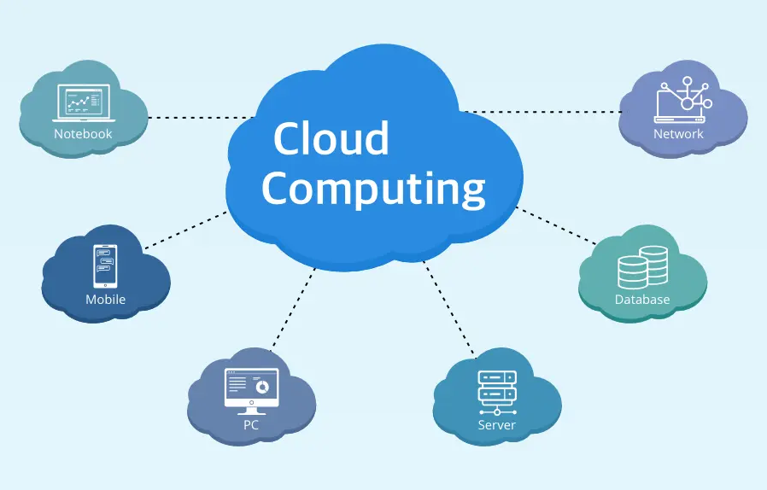
WHAT IS CLOUD COMPUTING ?
Definition:
  Storing and accessing data and programs over the internet instead of local hardware.
Key Points:
    Internet-based computing
    On-demand resources (storage, computing power)
    Examples: Google Drive, AWS, Microsoft Azure

Slide 4
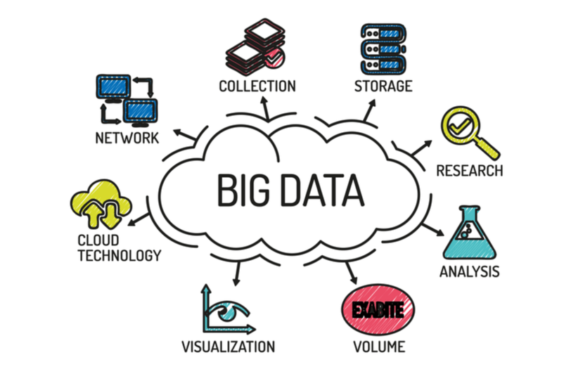
WHAT IS BIG DATA ?
Definition:
  Massive volumes of structured, semi-structured, and unstructured data that traditional systems cannot handle.
Key Points:
  3 V's: Volume, Velocity, Variety
  Examples of Big Data: Social media data, IoT data, e-commerce data
  Importance: Deriving insights for decision-making

Slide 5
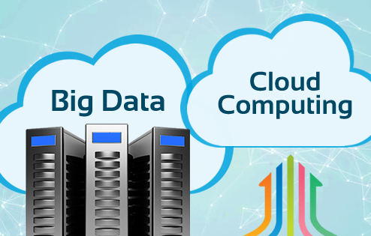
WHY CLOUD & BIG DATA ?
Key Points:
  Cloud enables scalable storage and processing for Big Data.
  Cost-efficiency: Pay only for what you use.
  Collaboration and accessibility anytime, anywhere.
  Solves storage and processing challenges of Big Data.

Slide 6
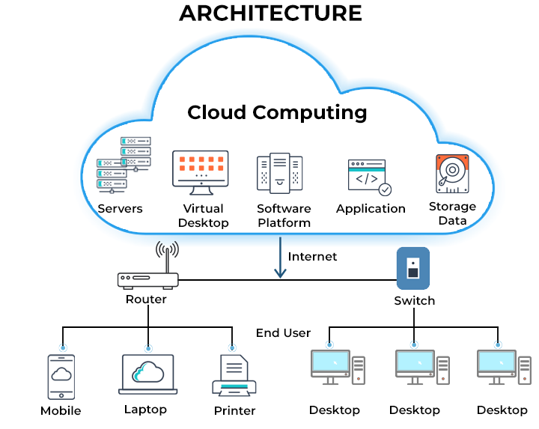
HOW CLOUD COMPUTINGWORKS ?
Key Points:
    Users access resources via the internet.
    Servers and data centers store/process the data.
    Services are divided into:
      IaaS (Infrastructure as a Service)
      PaaS (Platform as a Service)
      SaaS (Software as a Service)
    Example: Netflix uses AWS to stream videos.

Slide 7
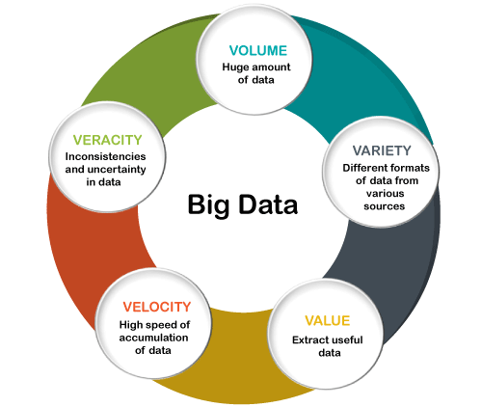
CHARACTERSTICS OF BIG DATA
Key Points:
  Volume: Petabytes or exabytes of data.
  Velocity: Real-time data streaming.
  Variety: Text, images, videos, audio.
  Veracity: Ensuring data accuracy.
  Value: Converting data into actionable insights.

Slide 8
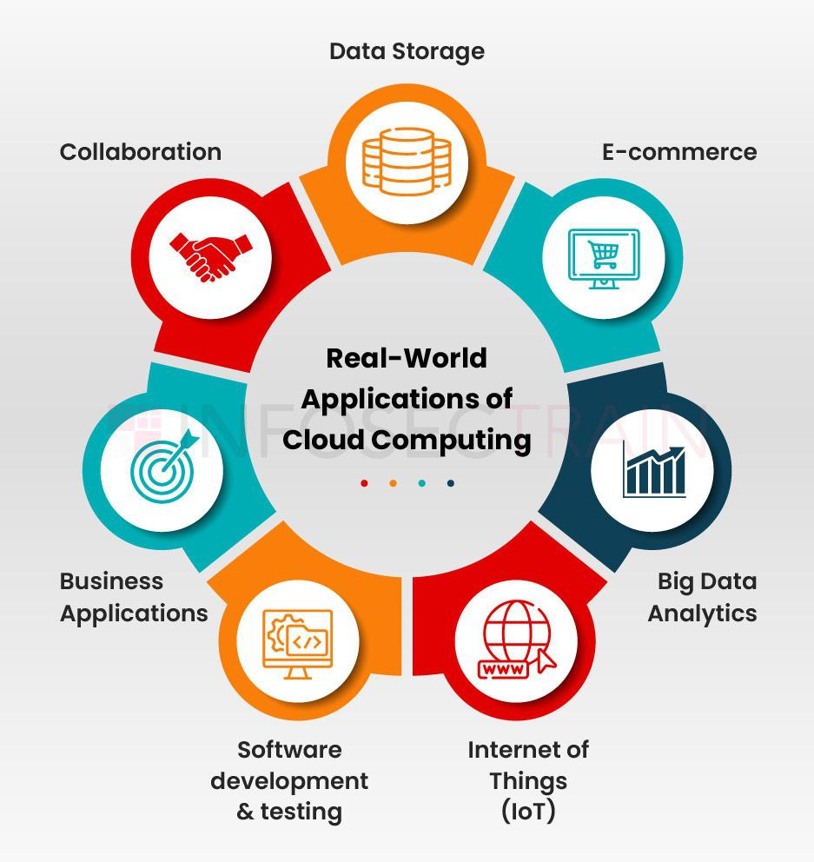
REAL WORLD APPLICATIONS
Key Points:
    Cloud Computing:
      Dropbox for file storage.
      Zoom for video conferencing.
    Big Data:
      Predictive analytics in healthcare.
      Personalized recommendations on e-commerce platforms.
    Combined:
      Smart city infrastructure.
      Fraud detection systems in finance.

Slide 9
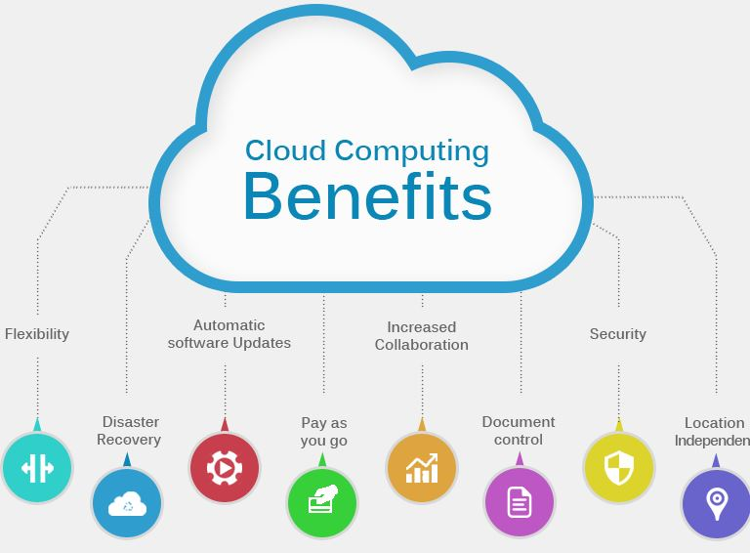
BENEFITS OF USING CLOUD & BIG DATA
Key Points:
  Cost savings.
  Scalability for growing businesses.
  Improved efficiency and decision-making.
  Real-time analytics and insights.

Slide 10
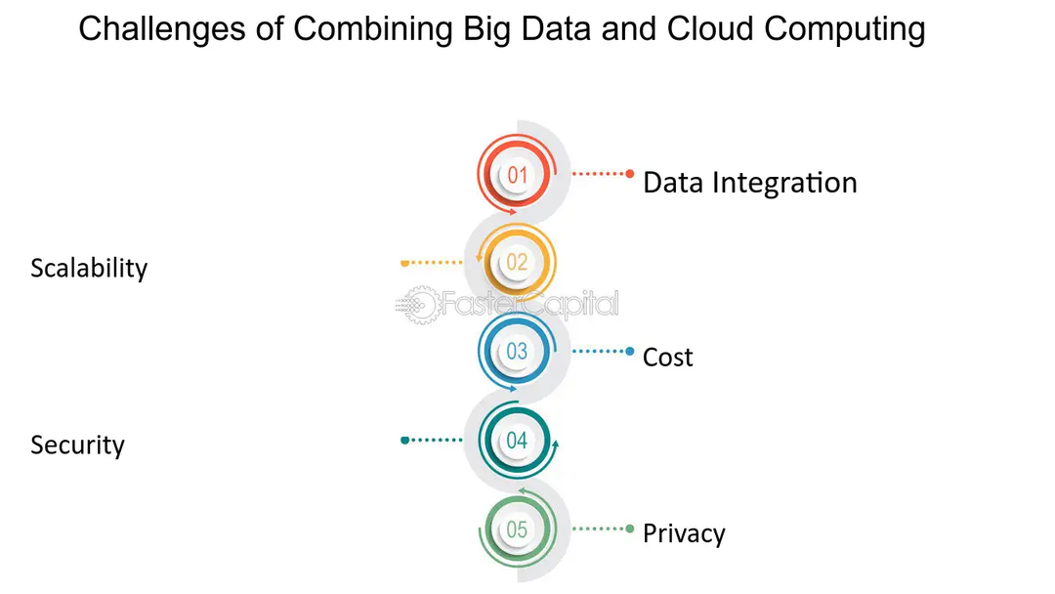
CHALLANGES AND CONSIDERATIONS
Key Points:
  Challenges:
    Data security and privacy.
    Managing and processing huge datasets.
  Considerations:
    Choose the right cloud service provider.
    Implement strong data governance.

Slide 11
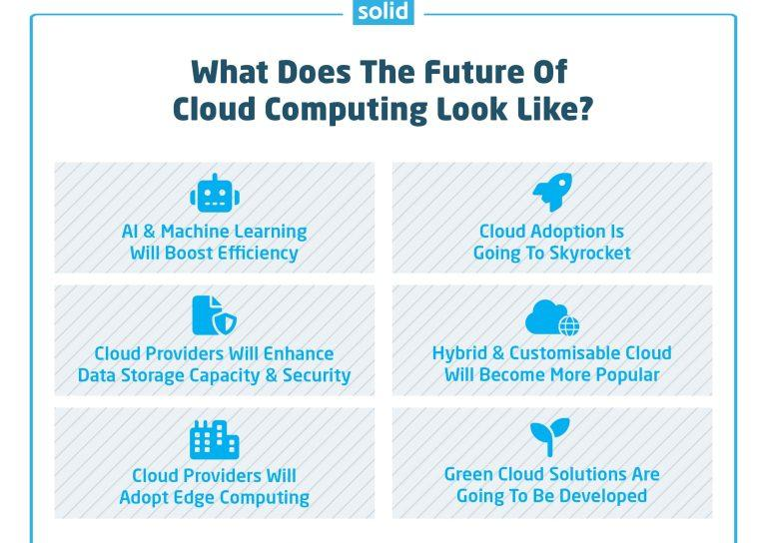
FUTURE OF CLOUD & BIG DATA
Key Points:
    Growth in AI and machine learning.
    Increased use of hybrid and multi-cloud strategies.
    Big Data driving innovations like autonomous vehicles and advanced healthcare systems.
    The rise of edge computing.

Slide 12
CONCLUSION
Key Points:
    Cloud computing provides resources; Big Data provides insights.
    Importance: Both are crucial for modern technological advancements.
    "Together, they are transforming how the world operates."

Slide 13


